Slide 1
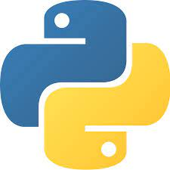
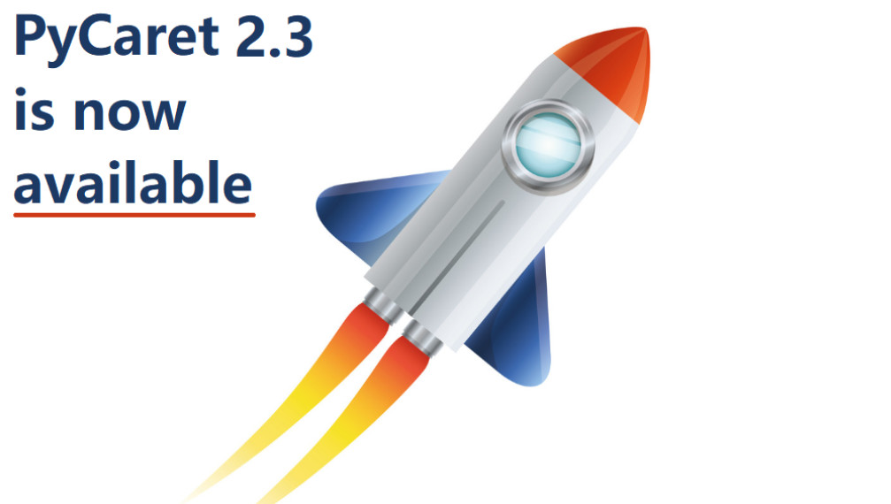


Journey from Caret to PyCaret
A Shallow Dive

Slide 2





Introduction to PyCaret
PyCaret is an open source, low-code machine learning library in Python that allows you to go from preparing your data to deploying your model within minutes in your choice of notebook environment.
PyCaret is essentially a Python wrapper around several machine learning libraries and frameworks such as scikit-learn, XGBoost, LightGBM, CatBoost, spaCy, Optuna, Hyperopt, Ray, and many more.
It is well suited for Citizen data scientists who want to increase the productivity of their ML experiments by using PyCaret in their workflows.
Inspired by caret creator Dr. Max Kuhn’s work in R. The name caret is short for Classification And REgression Training.
EASY TO USE
PRODUCTIVITY TOOL
BUSINESS READY

Slide 3
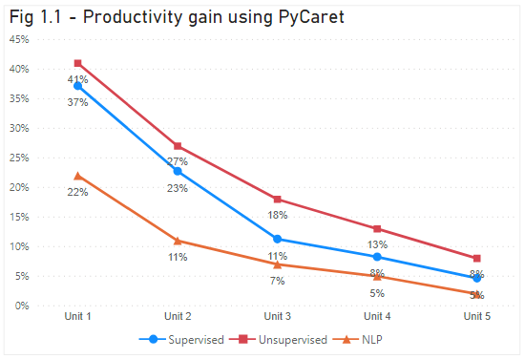
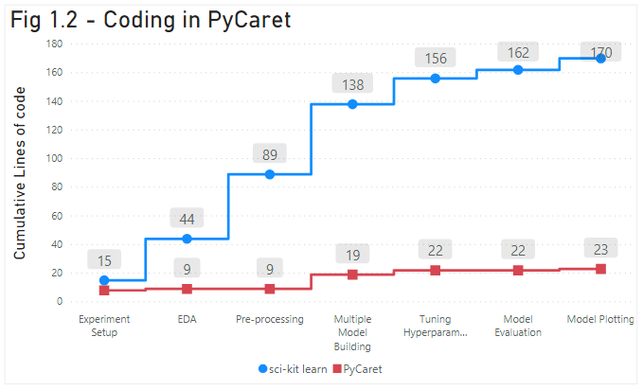
PyCaret Benefits
ML Modules
Classification
Regression
Clustering
Anomaly Detection
Natural Language Processing
Association Rule Mining
Time Series Forecasting

Slide 4
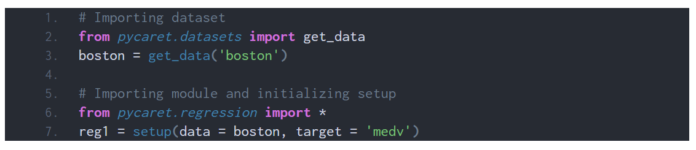
PyCaret Functions
Initialize
Model Training
Model Ensembling
Model Analysis
Model Deployment
ML FLOW
PyCaret has its own data repository like other libraries. You can import data from those libraries as well
Setting up the environment is the next step. Few examples are
Classification: from pycaret.classification import *
Regression: from pycaret.regression import *
Clustering: from pycaret.clustering import *
Notes:
https://towardsdatascience.com/supercharge-your-machine-learning-experiments-with-pycaret-and-gradio-5932c61f80d9

Slide 5

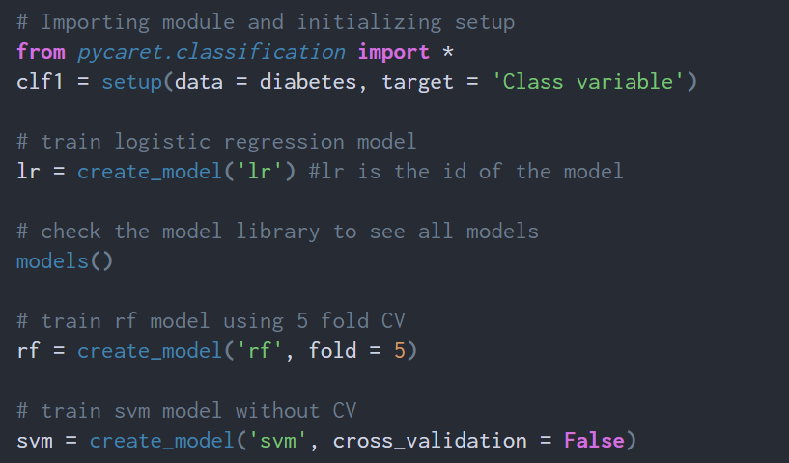
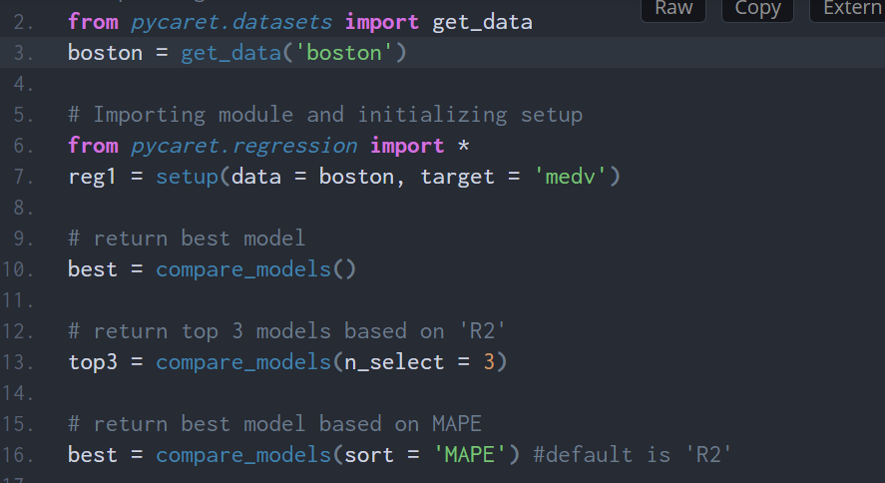
PyCaret Functions
Initialize
Model Training
Model Ensembling
Model Analysis
Model Deployment
ML FLOW
Model Training : You can use compare_models () function with specific models /default ones and sort the models based error metric – RMSE/AUC etc.
You can also use create_model() specifying the model name and fold parameter (default : 10 folds)
Notes:
https://towardsdatascience.com/supercharge-your-machine-learning-experiments-with-pycaret-and-gradio-5932c61f80d9

Slide 6
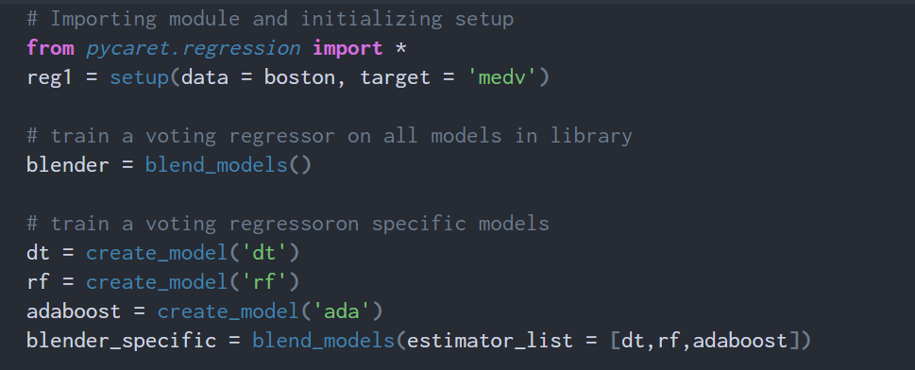
PyCaret Functions
Initialize
Model Training
Model Ensembling
Model Analysis
Model Deployment
ML FLOW
Tuning the model can be done in randomized grid search of a pre-defined search space hence it relies on number of iterations of search space.
Blending models is a method of ensembling which uses consensus among estimators to generate final predictions.
Notes:
https://towardsdatascience.com/supercharge-your-machine-learning-experiments-with-pycaret-and-gradio-5932c61f80d9

Slide 7
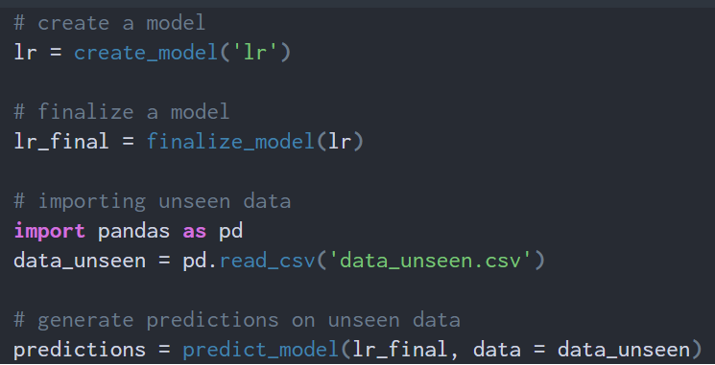
PyCaret Functions
Initialize
Model Training
Model Ensembling
Model Analysis
Model Deployment
ML FLOW
We can plot the model (AUC curve, Residuals plot) and interpret the model using SHAP
Predict the model using predict_model () function and the model can be deployed in AWS/Azure/GCP as well
Much More !!!!
Notes:
https://towardsdatascience.com/supercharge-your-machine-learning-experiments-with-pycaret-and-gradio-5932c61f80d9

Slide 8

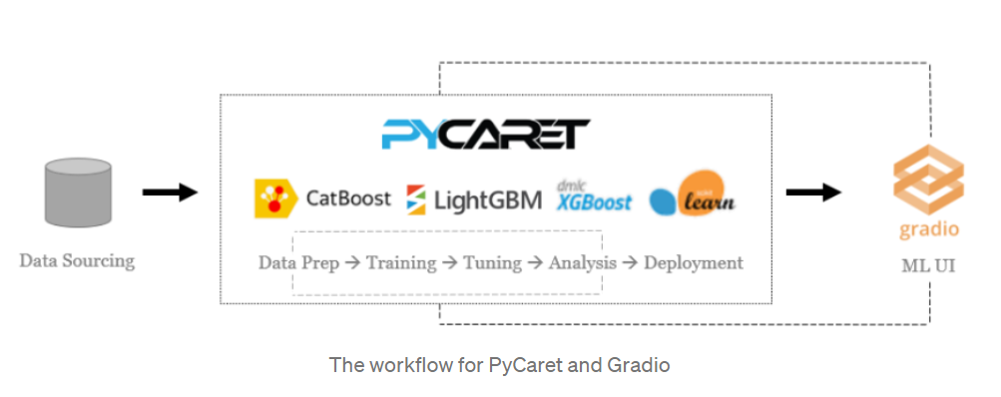
Gradio – Interface to ML models
Gradio is an open-source Python library for creating customizable UI components around your machine learning models.
Gradio makes it easy for you to “play around” with your model in your browser by dragging and dropping in your own images, pasting your own text, recording your own voice, etc., and seeing what the model outputs

Slide 9
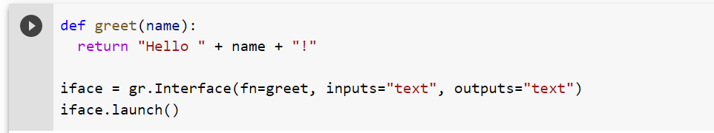

Gradio Example
PyCaret with Gradio Implementation
Demo Time !!!!
https://github.com/arunrajes/Pycaret_demo/blob/2e01576dfae3273e7c62477870fb6a8fe04d8190/Pycaret_regression_demo.ipynb

